Slide 1
LECTURE -04(b)
Inferential Statistics Part (a continued)
Course Instructor
Engr. Naina Said

Slide 2
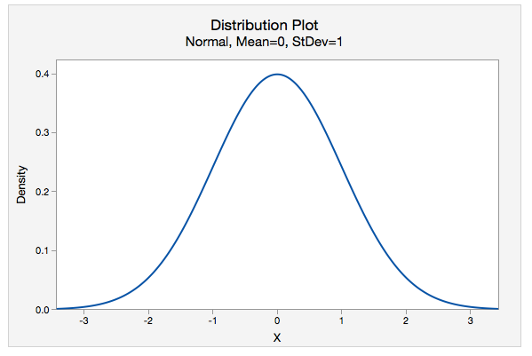
CSE-422: Data Analytics
Standard Normal Distribution
A special type of bell-shaped distribution with a mean of 0 and standard deviation of 1.

Slide 3
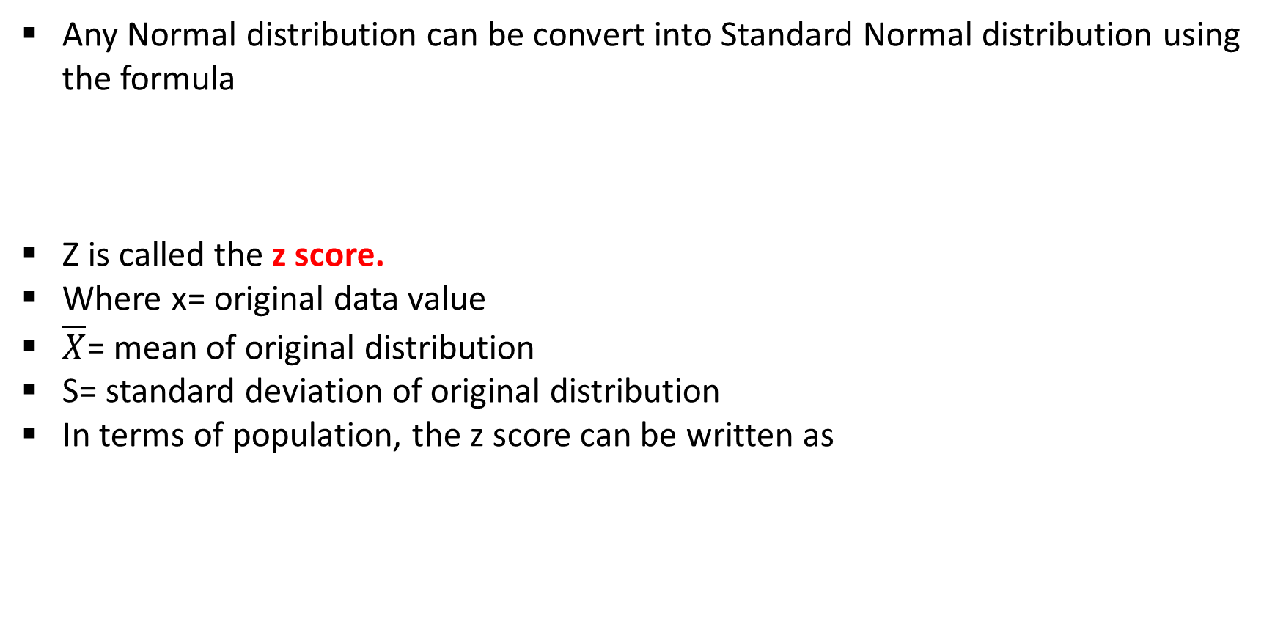
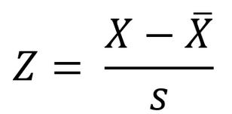
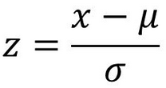
CSE-422: Data Analytics
Converting ND to SND

Slide 4
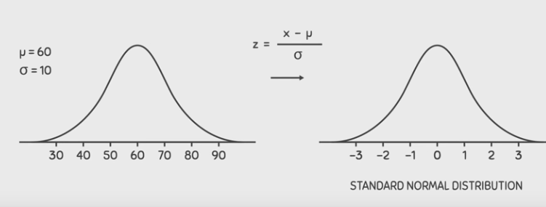
CSE-422: Data Analytics
Converting ND to SND

Slide 5
CSE-422: Data Analytics
Why do We Standardize?
Suppose Ahmad takes two courses with the following score distribution
Course A scores are normally distributed with a mean of 500 and standard deviation of 100.
Course B scores are normally distributed with a mean of 18 and standard deviation of 6.
Ahmad scores 600 in course A and 22 on course B.
In which course did Ahmad perform better?
We can not directly compare the scores because both scores have different scales.
So we standardize the scores (or in other words, bring them down to the same scale) and then compare.

Slide 6
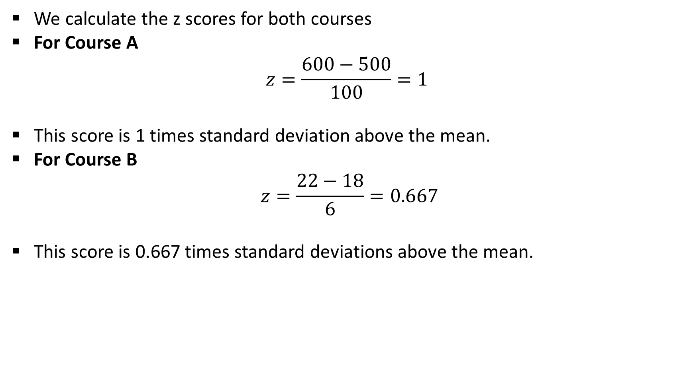
CSE-422: Data Analytics
Calculating the Z scores
Ahmad performed better on Course A than Course B because the z score is higher.

Slide 7
CSE-422: Data Analytics
Importance of Z scores
In statistics, we mostly use z-scores to evaluate data.
This is because its easier to compare different datasets with the help of z-scores no matter what the underlying units of the data are.
Z scores help us find any area under the curve with the help of z-table!
Z scores will heavily be used in
Confidence Interval Estimation.
Hypothesis Testing.

Slide 8
CSE-422: Data Analytics
Finding Probabilities Using the Z-Table

Slide 9
CSE-422: Data Analytics
Using the Z-Table
We have seen that the Empirical Rule (68% - 95% - 99.7%) subdivides the area under a normal distribution into sections with widths of one standard deviation.
These subdivisions are fine for determining percentages as long as we are dealing with values that fall at these exact subdivision locations.
What to do when we when a value does not fall on the empirical rule’s sub-division?
We convert the value to z-score.
We then use the Z-Score Table to find the corresponding probability.

Slide 10
CSE-422: Data Analytics
Using the Z-Table
Z- table tells us the area under the bell curve to the left of z score.
In this table, the top row and the left column correspond to the z scores and the middle values correspond to areas.
Negative scores in the z-table correspond to the values which are less than the mean.
Positive scores in the Z-table correspond to the values which are greater than the mean.

Slide 11
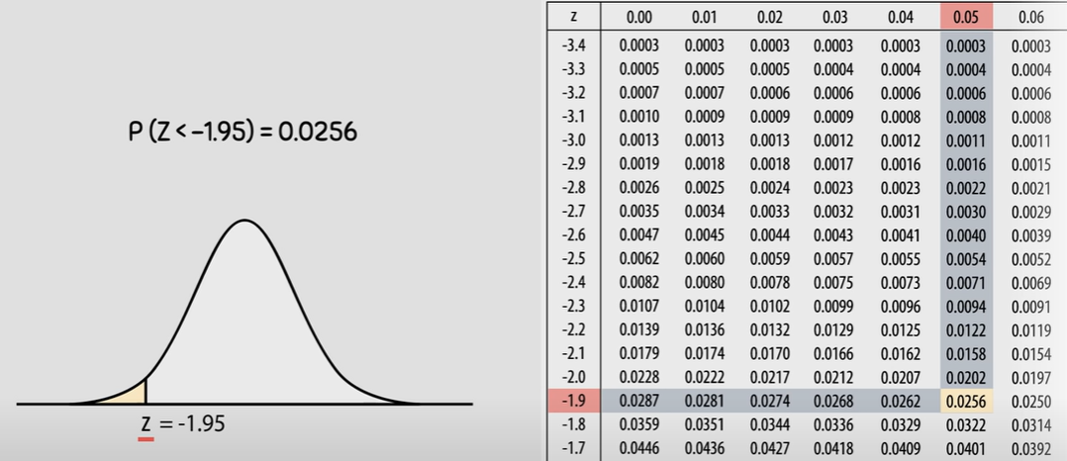
CSE-422: Data Analytics
Using the Z-Table

Slide 12
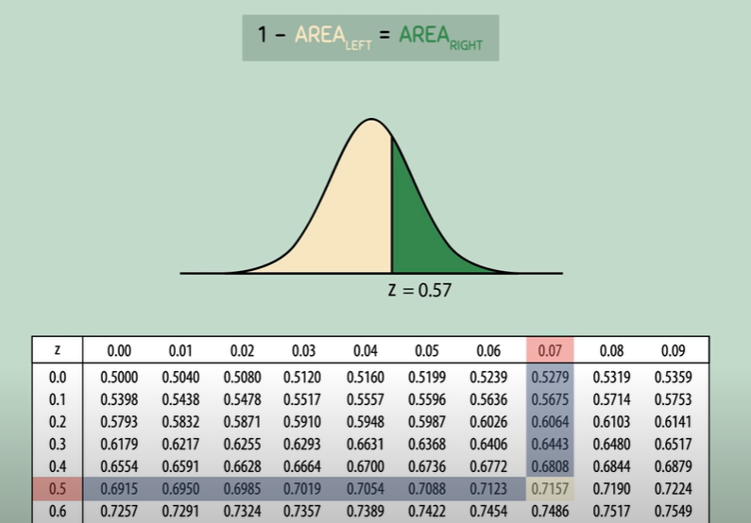
CSE-422: Data Analytics
Using the Z-Table
We can also use the z table to determine the area to the right of any z value.

Slide 13
CSE-422: Data Analytics
Example
A normally distributed population of test scores has a mean of 80 and a standard deviation of 5.2.
What is the percentage of scores that lies below 73? OR What is the probability that a student will get a score below 73?
What is the probability that a student will get a score between 82 and 86?
What is the probability that the student will get a score above 73?

Slide 14
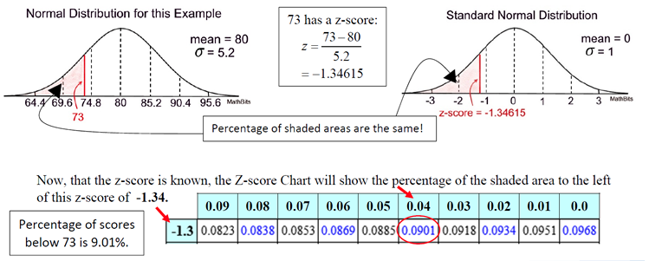
CSE-422: Data Analytics
Solution (a)

Slide 15
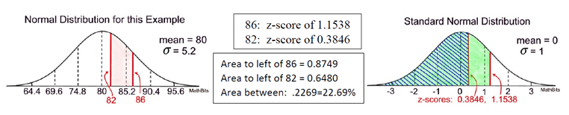
CSE-422: Data Analytics
Solution (b)

Slide 16
CSE-422: Data Analytics
Solution (c)
Remember the Z-Score table that are using gives you the area to the left of a particular Z-score.
To find the percentage of the area that lies "above" the z-score, take the total area under a normal curve (which is 1) and subtract the cumulative area to the left of the z-score
In part a, 73 had a z-score of -1.34615 with a cumulative area to the left of 0.0901 or 9.01%.
The area to the right of this z-score will be 1 - 0.0901 = 0.9099 or 90.99%.

Slide 17
CSE-422: Data Analytics
Central Limit Theorem

Slide 18
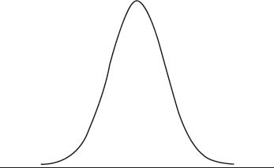
CSE-422: Data Analytics
Sampling Distribution
Suppose you select 100 teens from the population and plot their mean on a graph.
Then you take another 100 teens and plot their mean on the graph as well.
You repeat this process several times say 300 times.
The graph of these sample means is called “Sampling Distribution” and is likely to look like this.
Plot of Sample Means follows a bell curve!!

Slide 19
CSE-422: Data Analytics
Sampling Distribution Continued..
Remember, just because the sampling distribution follows a bell curve does not mean that the population was normally distributed!!!
No matter what the population distribution is, if you take many samples and then plot their means, the plot will follow normal distribution.

Slide 20
CSE-422: Data Analytics
Central Limit Theorem
For samples of size n, the distribution of sample means is
Is normal
Has a mean of μ
Has a standard deviation of σ/√n
The mean of the sample distribution represents the population mean.
The σ represents the population standard deviation.

Slide 21
CSE-422: Data Analytics
Central Limit Theorem
The CLT is a theorem that gives us a way to turn a non-normal distribution into a normal distribution.
It tells us that, even if a population distribution is non-normal, its sampling distribution of the sample mean will be normal for a large number of samples (at least 30)
The central limit theorem is useful because it lets us apply what we know about normal distributions, like the properties of mean, variance, and standard deviation, to non-normal distributions.
We will see this later in action.

Slide 22
CSE-422: Data Analytics
Acknowledgment
The content presented in this lecture is inspired by miscellaneous sources.

Slide 23
Quiz
The average test score in a math class follows normal distribution with mean 74 and the standard deviation 8. The total number of students in the test was 2000. How many students scored more than 98 marks in the test?

